Slide 1
SOFTWARE ENGINEERING

Slide 2
Unit 1 syllabus
Introduction to Software Engineering : The evolving role of software, Changing Nature of
Software, Software myths.
A Generic view of process : Software engineering- A layered technology, a process framework, The Capability Maturity Model Integration (CMMI), Process patterns, process assessment, personal and team process models.
Process models : The waterfall model, Incremental process models, Evolutionary process models, The Unified process.

Slide 3
Introduction to software Engineering
The Evolving role of software
Dual role of Software
    A Product
    - Information transformer-
    producing, managing and displaying
    A Vehicle for delivering a product
    - Control of computer(operating system),the communication of information(networks) and the creation of other programs

Slide 4
Introduction to software Engineering
Software is defined as
  Instructions
- Programs that when executed provide desired function
2. Data structures
-Enable the programs to adequately
manipulate information
3. Documents
-Describe the operation and use of the programs.

Slide 5
Introduction to software Engineering
Definition of Engineering
-Application of science, tools and methods to find cost effective solution to problems
Definition of SOFTWARE ENGINEERING
- SE is defined as systematic, disciplined and quantifiable approach for the development, operation and maintenance of software

Slide 6
Introduction to software Engineering
Characteristics of software
Software is developed or engineered, it is not manufactured in the classical sense.
Software does not wear out. However it deteriorates due to change.
Software is custom built rather than assembling existing components.
-Although the industry is moving towards component based construction, most software continues to be custom built

Slide 7

CHARACTERISTICS OF HARDWARE
Failure rate
“Infant mortality”
“Wear out”
Time
Fig: FAILURE CURVE FOR HARDWARE

Slide 8
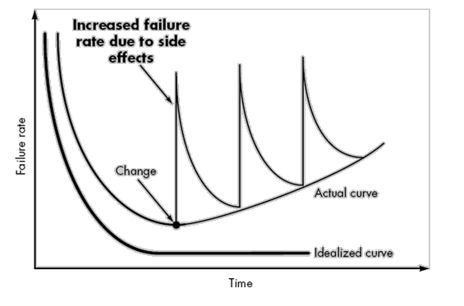
CHARACTERISTICS OF SOFTWARE
Fig: FAILURE CURVE FOR SOFTWARE

Slide 9
THE CHANGING NATURE OF SOFTWARE
Seven Broad Categories of software are challenges for software engineers
System software
Application software
Engineering and scientific software
Embedded software
Product-line software
Web-applications
Artificial intelligence software

Slide 10
THE CHANGING NATURE OF SOFTWARE
System software. System software is a collection of programs written to service other programs
Embedded software
-- resides in read-only memory
--is used to control products and systems for the consumer and industrial markets.
Artificial intelligence software. Artificial intelligence (AI) software makes use of nonnumeric algorithms to solve complex problems that are not amenable to computation or straightforward analysis
Engineering and scientific software. Engineering and scientific software have been characterized by "number crunching" algorithms.

Slide 11
LEGACY SOFTWARE
Legacy software are older programs that are developed decades ago.
The quality of legacy software is poor because it has inextensible design,convoluted code,poor and nonexistent documentation,test cases and results that are not achieved.

Slide 12
As time passes legacy systems evolve due to following reasons:
  The software must be adapted to meet the needs of new computing environment or technology.
  The software must be enhanced to implement new business requirements.
  The software must be extended to make it interoperable with more modern systems or database
  The software must be rearchitected to make it viable within a network environment.

Slide 13
Software Evolution
Software evolves due to changes
Changes occur due to correction,adaption and enhancement
8 Laws of unified theory of s/w evolutions:
    The Law of Continuing Change.[1974]
    The Law of Increasing Complexity.[1974]
    The Law of Self-Regulation[1974]
    The Law of Conservation of Organizational Stability.[1980]
    The Law of Conservation of Familiarity[1980]
    The Law of Continuing Growth[1980]
    The Law of Declining Quality[1996]
    The Feedback System Law[1996]

Slide 14
SOFTWARE MYTHS
Widely held but false view
Propagate misinformation and confusion
Three types of myth
- Management myth
- Customer myth
- Practitioner’s myth

Slide 15
MANAGEMENT MYTHS
Myth(1)
-The available standards and procedures for software are enough.
Myth(2)
-Each organization feel that they have state-of-art software development tools since they have latest computer.
Myth(3)
-Adding more programmers when the work is behind schedule can catch up.
Myth(4)
-Outsourcing the software project to third party, we can relax and let that party build it.

Slide 16
CUSTOMER MYTH
Myth(1)
- General statement of objective is enough to begin writing programs, the details can be filled in later.
Myth(2)
-Software is easy to change because software is flexible

Slide 17
PRACTITIONER’S MYTH
Myth(1)
-Once the program is written, the job has been done.
Myth(2)
-Until the program is running, there is no way of assessing the quality.
Myth(3)
-The only deliverable work product is the working program
Myth(4)
-Software Engineering creates voluminous and unnecessary documentation and invariably slows down software development.

Slide 18




SOFTWARE ENGINEERING-A LAYERED TECHNOLOGY
Fig: Software Engineering-A layered technology

Slide 19
SOFTWARE ENGINEERING-A LAYERED TECHNOLOGY
Quality focus
- Bedrock that supports software Engineering.
Process
- Foundation for software Engineering
Methods
- Provide technical How-to’s for building software
Tools
- Provide semi-automatic and automatic support to methods

Slide 20
A PROCESS FRAMEWORK
Establishes the foundation for a complete software process
Identifies a number of framework activities applicable to all software projects
Also include a set of umbrella activities that are applicable across the entire software process.

Slide 21


A PROCESS FRAMEWORK
Common process framework
Framework activities
TTTasks
Milestones,delierables
SQA points
Umbrella activities

Slide 22
A PROCESS FRAMEWORK
Used as a basis for the description of process models
Generic process activities
    Communication
    Planning
    Modeling
    Construction
    Deployment

Slide 23
A PROCESS FRAMEWORK
Generic view of engineering complimented by a number of umbrella activities
      Software project tracking and control
      Formal technical reviews
      Software quality assurance
      Software configuration management
      Document preparation and production
      Reusability management
      Measurement
      Risk management

Slide 24
CAPABILITY MATURITY MODEL INTEGRATION(CMMI)
Developed by SEI(Software Engineering institute)
Assess the process model followed by an organization and rate the organization with different levels
A set of software engineering capabilities should be present as organizations reach different levels of process capability and maturity.
CMMI process meta model can be represented in different ways
1.A continuous model
2.A staged model
Continuous model:
-Lets organization select specific improvement that best meet its business objectives and minimize risk
-Levels are called capability levels.
-Describes a process in 2 dimensions
-Each process area is assessed against specific goals and practices and is rated according to the following capability
levels.

Slide 25
CMMI
Six levels of CMMI
  Level 0:Incomplete
  Level 1:Performed
  Level 2:Managed
  Level 3:Defined
  Level 4:Quantitatively managed
  Level 5:Optimized

Slide 26
CMMI
INCOMPLETE
-Process is adhoc.Objective and goal of process areas are not known
Performed
-Goal,objective,work tasks,work products and other activities of software process are carried out
Managed
-Activities are monitored, reviewed, evaluated and controlled
Defined
-Activities are standardized, integrated and documented
Quantitatively Managed
-Metrics and indicators are available to measure the process and quality
Optimized
- Continuous process improvement based on quantitative feed back from the user
-Use of innovative ideas and techniques, statistical quality control and other methods for process improvement.

Slide 27
CMMI
Staged model
- This model is used if you have no clue of how to improve the process for quality software.
- It gives a suggestion of what things other organizations have found helpful to work first
- Levels are called maturity levels

Slide 28
LEVEL | FOCUS | PROCESS AREA
Optimizing | Continuous process Improvement | -Organizational Innovation and Deployment -Causal Analysis and Resolution
Quantitatively managed | Quantitative management | -Organizational process performance -Quantitative project management
Defined | Process standardized | Requirements Development Technical Solution Product Integration Verification Validation Organizational Process Focus Organizational Process Definition Organizational Training Integrated Project Management Risk Management

Slide 29
 |  | Integrated Teaming Integrated Supplier Management Decision Analysis and Resolution Organizational Environment for Integration
Managed | Basic project management | Requirements Management Project Planning Project Monitoring and Control Supplier Agreement Measurement and Analysis Process and Product Quality Assurance Configuration Management
Performed

Slide 30
PROCESS PATTERNS
Software Process is defined as collection of Patterns
Process pattern provides a template
Process Template
-Pattern Name
-Intent
-Type
-Task pattern
- Stage pattern
-Phase Pattern
Initial Context
Problem
Solution
Resulting Context
Related Patterns

Slide 31
PROCESS ASSESSMENT
Does not specify the quality of the software or whether the software will be delivered on time or will it stand up to the user requirements.
It attempts to keep a check on the current state of the software process with the intention of improving it.

Slide 32
PROCESS ASSESSMENT
Software Process
Examined by
Software Process
Assessment
Capabilities & Risk
Identifies
Identifies
Modification to
Leads to
Leads to
Software Process
improvement
Capability determination
Motivates

Slide 33
APPROACHES TO SOFTWRE ASSESSMENT
Standard CMMI assessment (SCAMPI)
CMM based appraisal for internal process improvement
SPICE(ISO/IEC 15504)
ISO 9001:2000 for software

Slide 34
Personal and Team Software Process
Personal software process
PLANNING
HIGH LEVEL DESIGN
HIGH LEVEL DESIGN REVIEW
DEVELOPMENT
POSTMORTEM

Slide 35
Personal and Team Software Process
Team software process
Goal of TSP
Build self-directed teams
Motivate the teams
Acceptance of CMM level 5 behavior as normal to accelerate software process improvement
Provide improvement guidance to high maturity organization

Slide 36
PROCESS MODELS
Help in the software development
Guide the software team through a set of framework activities
Process Models may be linear, incremental or evolutionary

Slide 37
THE WATERFALL MODEL
Used when requirements are well understood in the beginning
Also called classic life cycle
A systematic, sequential approach to Software development
Begins with customer specification of Requirements and progresses through planning, modeling, construction and deployment

Slide 38
The Waterfall Model
This Model suggests a systematic, sequential approach to SW development that begins at the system level and progresses through analysis, design, code and testing
Communication
Project initiation
requirement gathering
Planning
Estimating
Scheduling
tracking
Modeling
Analysis
design
Construction
Code
test
Deployment
Delivery
Support
feedback

Slide 39
PROBLEMS IN WATERFALL MODEL
Real projects rarely follow the sequential flow since they are always iterative
The model requires requirements to be explicitly spelled out in the beginning, which is often difficult
A working model is not available until late in the project time plan

Slide 40
THE INCREMENTAL PROCESS MODEL
Linear sequential model is not suited for projects which are iterative in nature
Incremental model suits such projects
Used when initial requirements are reasonably well-defined and compelling need to provide limited functionality quickly
Functionality expanded further in later releases
Software is developed in increments

Slide 41
The Incremental Model
Communication
Planning
Modeling
Construction
Deployment
Increment # n
Communication
Planning
Modeling
Analysis
design
Construction
Code
test
Deployment
Delivery
Support
feedback
delivery of
nth increment
Software functionality and features
Increment#2
Communication
Planning
Modeling
Analysis
design
Construction
Code
test
Increment # 1
Deployment
Delivery
Support
feedback
Delivery of
2nd increment
Communication
Planning
Modeling
Analysis
design
Construction
Code
test
Deployment
Delivery
Support
feedback
delivery of
1ST increment
Project calendar time

Slide 42
THE INCREMENTAL MODEL
Software releases in increments
1st increment constitutes Core product
Basic requirements are addressed
Core product undergoes detailed evaluation by the customer
As a result, plan is developed for the next increment
Plan addresses the modification of core product to better meet the needs of customer
Process is repeated until the complete product is produced

Slide 43
THE RAD MODEL
(Rapid Application Development)
An incremental software process model
Having a short development cycle
High-speed adoption of the waterfall model using a component based construction approach
Creates a fully functional system within a very short span time of 60 to 90 days

Slide 44
The RAD Model
Team # n
Modeling
Business modeling
Data modeling
Process modeling
Communication
Team # 2
Construction
Component reuse
automatic code
generation
testing
Modeling
Business modeling
Data modeling
Process modeling
Planning
Construction
Component reuse
automatic code
generation
testing
Team # 1
Modeling
Business modeling
Data modeling
Process modeling
Deployment
integration
delivery
feedback
Construction
Component reuse
automatic code
generation
testing

Slide 45
THE RAD MODEL
Multiple software teams work in parallel on different functions
Modeling encompasses three major phases: Business modeling, Data modeling and process modeling
Construction uses reusable components, automatic code generation and testing
Problems in RAD
Requires a number of RAD teams
Requires commitment from both developer and customer for rapid-fire completion of activities
Requires modularity
Not suited when technical risks are high

Slide 46
EVOLUTIONARY PROCESS MODEL
Software evolves over a period of time
Business and product requirements often change as development proceeds making a straight-line path to an end product unrealistic
Evolutionary models are iterative and as such are applicable to modern day applications
Types of evolutionary models
  Prototyping
  Spiral model
  Concurrent development model

Slide 47
PROTOTYPING
Mock up or model( throw away version) of a software product
Used when customer defines a set of objective but does not identify input,output,or processing requirements
Developer is not sure of:
  efficiency of an algorithm
  adaptability of an operating system
  human/machine interaction

Slide 48
Evolutionary Models: Prototype
Communication
Quick
Plan
Modeling
Quick design
Construction
of prototype
Deployment
delivery &
feedback

Slide 49
STEPS IN PROTOTYPING
Begins with requirement gathering
Identify whatever requirements are known
Outline areas where further definition is mandatory
A quick design occur
Quick design leads to the construction of prototype
Prototype is evaluated by the customer
Requirements are refined
Prototype is turned to satisfy the needs of customer

Slide 50
LIMITATION OF PROTOTYPING
In a rush to get it working, overall software quality or long term maintainability are generally overlooked
Use of inappropriate OS or PL
Use of inefficient algorithm

Slide 51
THE SPIRAL MODEL
An evolutionary model which combines the best feature of the classical life cycle and the iterative nature of prototype model
Include new element : Risk element
Starts in middle and continually visits the basic tasks of communication, planning,modeling,construction and deployment

Slide 52
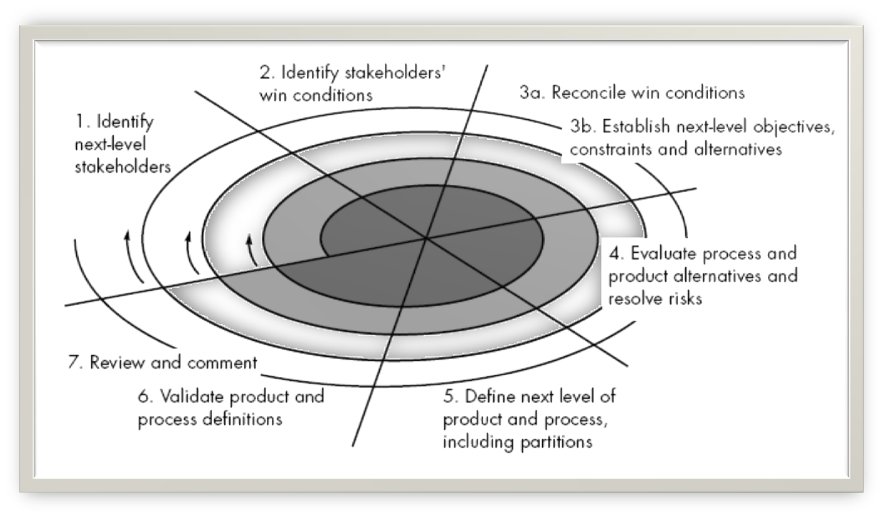
Evolutionary Models: The Spiral

Slide 53
THE SPIRAL MODEL
1.COMMUNICATION
*Tasks required are establish effective communication between developer
2.PLANNING
*Estimation
*Scheduling
*Risk analysis
MODELING *Analysis *Design
CONSTRUCTION *Code *Test
DEPLOYMENT *Delivery *Feedback

Slide 54
THE SPIRAL MODEL
Realistic approach to the development of large scale system and software
Software evolves as process progresses
Better understanding between developer and customer
The first circuit might result in the development of a product specification
Subsequent circuits develop a prototype
And sophisticated version of software

Slide 55
THE CONCURRENT DEVELOPMENT MODEL
Also called concurrent engineering
Constitutes a series of framework activities, software engineering action, tasks and their associated states
All activities exist concurrently but reside in different states
Applicable to all types of software development
Event generated at one point in the process trigger transitions among the states

Slide 56
A FINAL COMMENT ON EVOLUTIONARY PROCESS
Difficult in project planning
Speed of evolution is not known
Does not focus on flexibility and extensibility (more emphasis on high quality)
Requirement is balance between high quality and flexibility and extensibility

Slide 57
THE UNIFIED PROCESS
Evolved by Rumbaugh, Booch, Jacobson
Combines the best features their OO models
Adopts additional features proposed by other
experts
Resulted in Unified Modeling Language(UML)
Unified process developed Rumbaugh and Booch
A framework for Object-Oriented Software Engineering using UML

Slide 58
PHASES OF UNIFIED PROCESS
INCEPTION PHASE
ELABORATION PHASE
CONSTRUCTION PHASE
TRANSITION PHASE

Slide 59
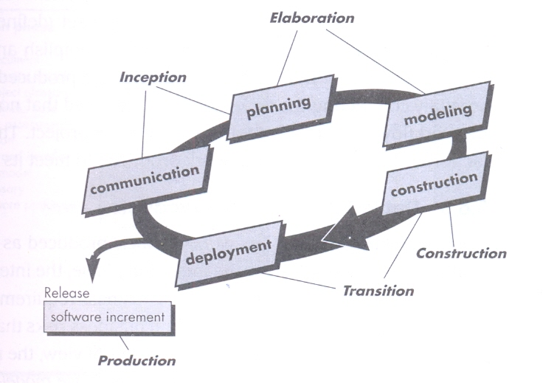
The Unified Process (UP)

Slide 60
UNIFIED PROCESS WORK PRODUCTS
Tasks which are required to be completed during different phases
Inception Phase *Vision document *Initial Use-Case model *Initial Risk assessment *Project Plan
Elaboration Phase *Use-Case model *Analysis model *Software Architecture description *Preliminary design model *Preliminary model

Slide 61
UNIFIED PROCESS WORK PRODUCTS
Construction Phase *Design model *System components *Test plan and procedure *Test cases *Manual
Transition Phase *Delivered software increment *Beta test results *General user feedback

